Slide 1


HIREVIEW
A skill-based resume filtering software that provides an ease and automation to selecting the best candidates for a particular job .

Slide 2



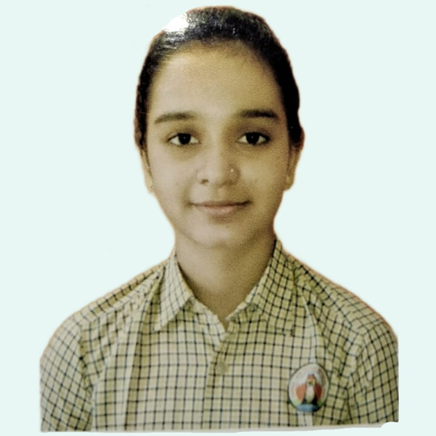



Our Team
Satvik Parihar
23002170510039
A-1
AIDS
Shivam Shukla
23002170510041
A-1
AIDS
Kavya Pandya
23002170510016
A-1
AIDS
Dev Patel
23002170510026
A-1
AIDS
Kunal Fauzdar
23002170110073
A-1
CE

Slide 3

PROBLEM-STATEMENT
Every Tech Student wishes to work in a big and well-established Technology based company and it is common for these big Tech-Companies to get thousands of applicants with pages of resumes to read through . Not only do they need to study all of these but also shortlist the best available candidates whose skills are a fit to the required role . And even after this scrutinization , they have to look for the contact details of these applicants

Slide 4

ABOUT PROJECT
1.
HIREVIEW deals with this lengthy task of reading through resumes and sorts candidates based on their skills which are required by the company for their post .
2.
It also maintains a record of all candidates’ data and allows the company to view details of a particular candidate also .

Slide 5




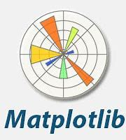

Python is used as a back-end programming language and the whole code is written and executed using different libraries in python .
MySQL is used as a Database Management System to store the various details of the applicants and their Respective Skills .
The whole code is written and compiled Jupyter Notebook and the output is shown in its console .
Matplotlib library is used for visualization and various graphs are shown using it .
TOOLS
USED
Pandas is used to create DataFrames and store the data retrieved from Database and apply analysis processes over them .

Slide 6

WORKING
On execution the program takes user input and asks from the following options :
The user can scan resumes
The user can view the names and IDs of all applicants
The user can view skills of a particular participant , provided they know his/her ID
The user can view the top 5 applicants’ name and ID
The user can get a list of applicants based on a particular skill
While Scanning resumes , the user can either provide a single resume or a folder of resumes (file-path) the program will automatically scan pdf and doc formats and upload the extracted details on the database .
Using MySQL-connector these details are extracted and stored in Pandas DataFrame and NumPy arrays and analysis and filtering is carried out .
Output is displayed considering the user choice and finally charts are generated using matplotlib .

Slide 7

FUTURE SCOPE
Integration of AI for more enhanced sorting .
Integration of front-end for a more user-friendly and appealing interface to interact with .
Enhanced search options .
Displaying detailed crux of resume of all shortlisted applicants .
An applicant interface to check their eligibility before applying for a role .
Considering factors other than just skills for shortlisting .
Training a Natural Learning Process (NLP) for different resume formats

Slide 8


